Slide 1


Formal Design, Implementation and Verification of Blockchain Languages and Virtual Machines
Grigore Rosu
University of Illinois at Urbana-Champaign, USA
Runtime Verification, Inc.
11 October 2018, FACS’18, Pohang, Korea

Slide 2

Cryptocurrency – The future of Money? Built on Blockchain Technology
Top 5 hold more than $200B market cap!

Slide 3
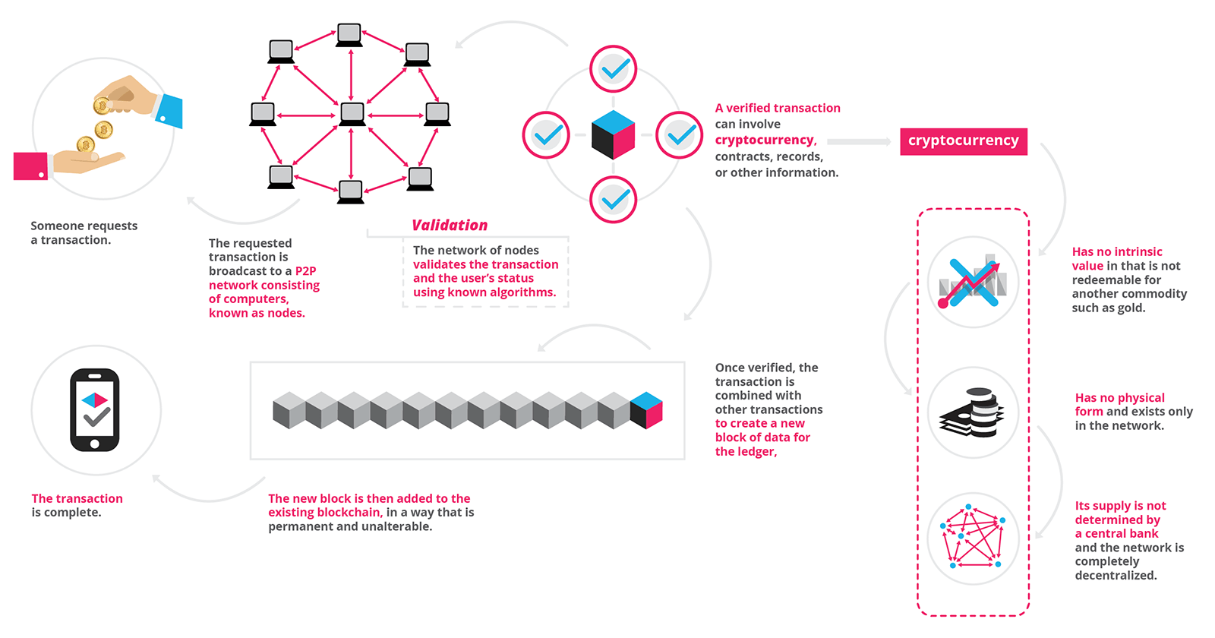
Blockchain Technology Unprecedented Security Challenges
Think “execute some given, publicly visible code, with shared state”!
Transaction is broadcast, then “validated” by re-executing it on many “nodes”, using agreed upon languages (virtual machines)
Validated transactions are then deployed by all nodes locally…
Some transactions add new code to the blockchain, called “smart contracts”, which can be executed by other transactions.
…in blocks, appending each block, irreversibly, to the public “ledger” or “history” or “blockchain”.
In the end, all code is public, can be invoked by anybody, and can irreversibly change the history (e.g., steal your money).
Hackers have huge incentives to exploit any bugs in smart contracts or underlying infrastructure.

Slide 4
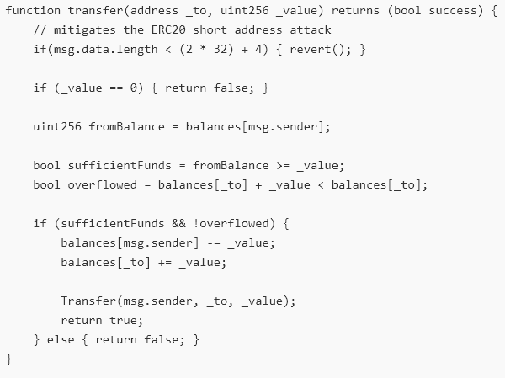

Smart Contract Snippet (ERC20) (one of the ~40,000 Ethereum ERC20s)
Written in Solidity:
…
ERC20 does not state that…
There should be no overflow when self-transfer…
Wrong: returns false even though there is no overflow (self-transfer)

Slide 5
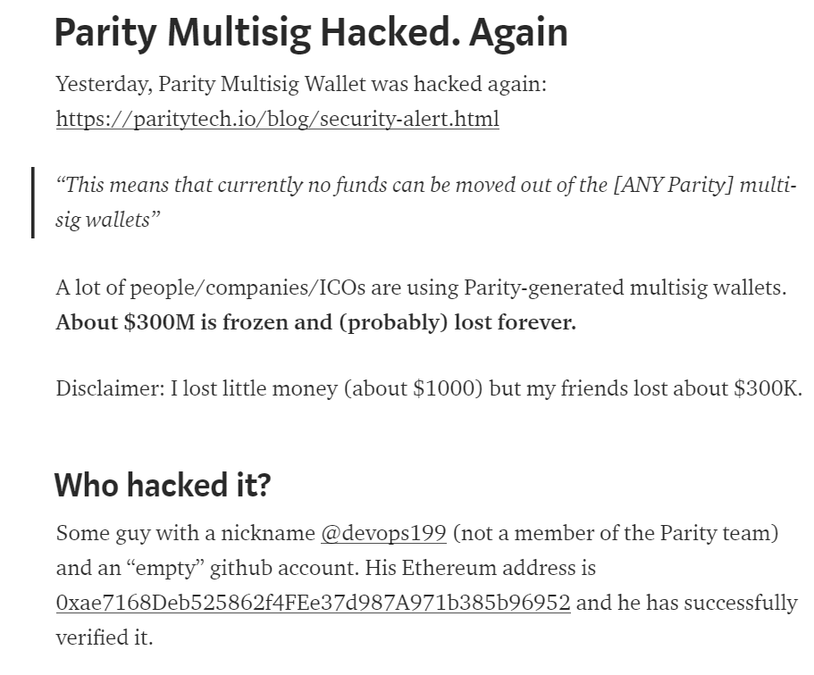
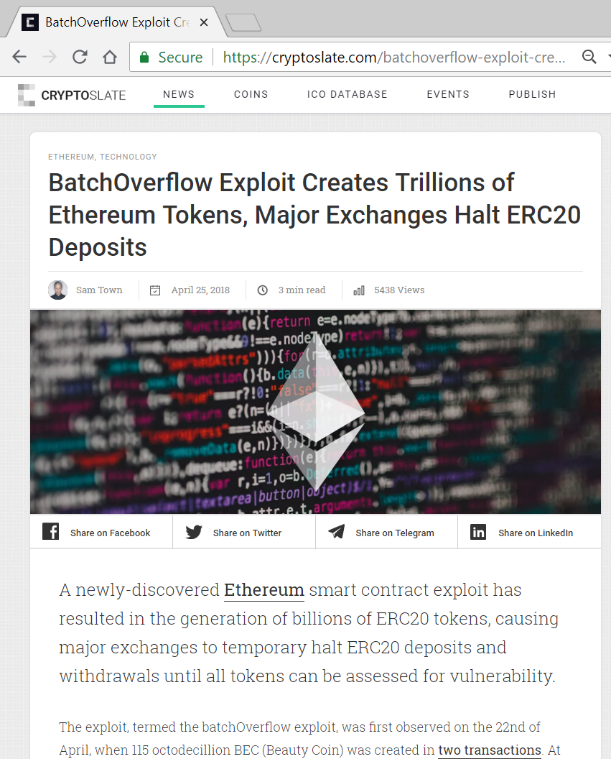
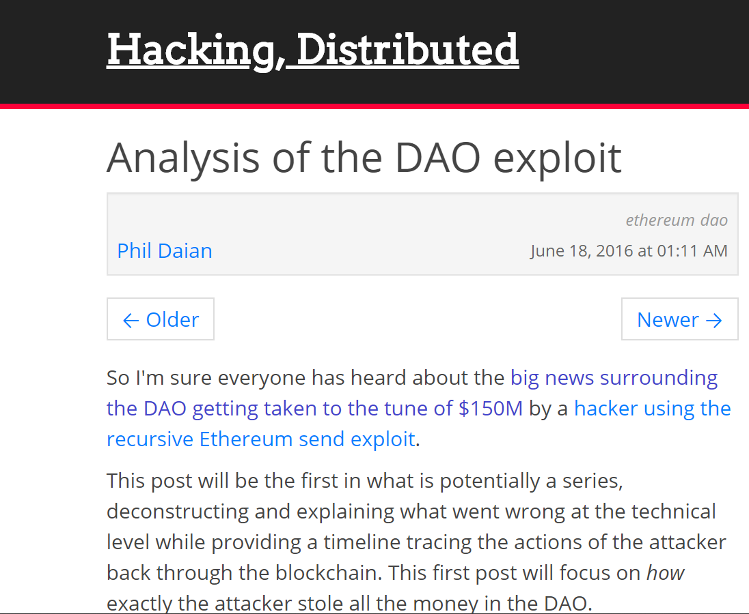
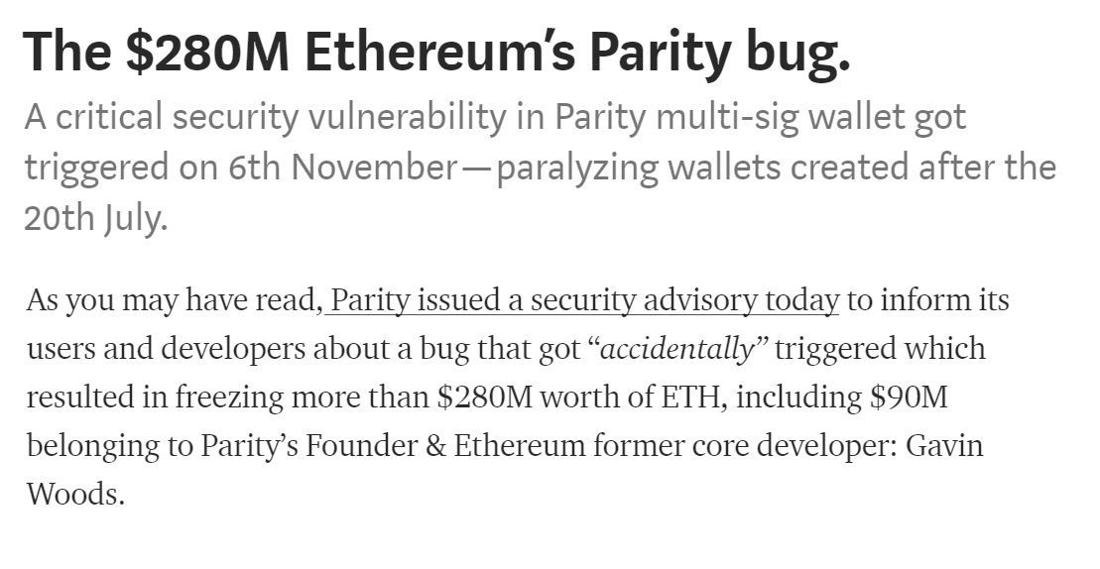
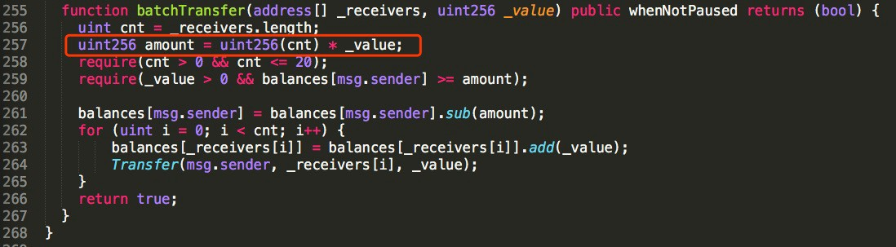
Attacks Happened. Many.
That’s larger than $10⁷⁰!

Slide 6

What Can We Do About This?
More specifically, what can we do about the execution environment, to increase security?
Unacceptable to build this complex and disruptive technology with poorly designed VMs and languages!
Ideal scenario feasible, stop compromising!
Everything must be rigorously designed, using formal methods. Implementations must be provably correct!
Nodes: provably correct VMs or interpreters
Smart contracts: use well-designed programming languages, with provably correct compilers or interpreters
Verification: Smart contracts provably correct wrt their specs
Many languages … +
Provably correct …
---------------------------
Language framework!

Slide 7
Ideal Language Framework Vision
…
Deductive program verifier
Parser
Interpreter
Formal Language Definition
(Syntax and Semantics)
Model checker
Compiler
Symbolic execution
(semantic) Debugger
Notes:
K is a language design framework and suite of tools.
Its vision is to allow and encourage the language designers to formally define their languages once and for all, using an intuitive and attractive notation, and then obtain essentially for free implementations as well as analysis tools for the defined languages.
This is a long-standing dream of the programming language community.
Our objective in the K project is to develop the foundations, techniques, and tools to make this dream a reality.

Slide 8
Our Attempt: the K Framework http://kframework.org
We tried various semantic styles, for ~15y
Small-/big-step SOS; Evaluation contexts; Abstract machines (CC, CK, CEK, SECD, …); Chemical abstract machine; Axiomatic; Continuations; Denotational;…
But each of the above had limitations
Especially related to modularity, notation, verification
K framework initially engineered: keep advantages and avoid limitations of various semantic styles
Then theory came

Slide 9
Complete K Definition of KernelC
Notes:
Here is a complete definition of a fragment of C, called KernelC, as generated by the K tool.
The left column defines its formal syntax and the other two its formal semantics.
I will next zoom through this definition and highlight some of the K tool’s features.

Slide 10
Complete K Definition of KernelC
Syntax declared using annotated BNF
…
Notes:
Syntax is declared using the conventional BNF notation, annotated with K attributes (in blue).
For example, assignment is an expression construct taking two expression arguments (the left one can be a variable x, a pointer *x, etc.; we only discuss the former case here).
The “strict(2)” annotation states that assignment is strict in the second argument, that is, that argument needs to be evaluated first.
The semantic rule of assignment, which we discuss shortly, then can assume that the second argument is already a value.

Slide 11
Complete K Definition of KernelC
Configuration given as a nested cell structure.
Leaves can be sets, multisets, lists, maps, or syntax
Notes:
K makes heavy use of configurations, which in the tool can be defined and initialized in a user friendly and colorful way.
A configuration can be regarded as a snapshot of the program execution: it includes the remaining program, together with all the necessary semantic information to execute it.
K configurations are organized as nested cell structures, whose leaves hold basic data organized in lists, maps, sets, etc.
Cells can be referred to by their name; their order is irrelevant.
In KernelC, the k cell holds the remaining code, funs the set of functions, env the current environment, mem the current heap, fstack the current function stack, in and out the current input/output buffers, ptr the current malloc/free pointer map, and so on.

Slide 12
Complete K Definition of KernelC
Semantic rules given contextually
rule
<k> X = V => V …</k>
<env>… X |-> (_ => V) …</env>
Notes:
Once the syntax and configuration are defined, we can start adding semantic rules.
K rules are contextual: they mention a configuration context in which they apply, together with local changes they make to that context.
To enhance the modularity of your language definition, you typically aim at only mentioning the absolutely necessary context in your rules; the remaining details are filled in automatically by the tool.
For example, here is the K rule for assignment, both in graphical and in ASCII formats; we only discuss the graphical notation here.
Recall that assignment was strict(2), so we can assume that its second argument is a value, say V.
The context of this rule involves two cells, the k cell which holds the current code and the env cell which holds the current environment.
Moreover, from each cell, we only need certain pieces of information: from the k cell we only need the first task, which is the assignment X=V, and from the env cell we only need the binding X |-> _. The underscore stands for an anonymous variable, the intuition here being that that value is discarded anyway, so there is no need to bother naming it.
The unnecessary parts of the cells, which we call frames, are metaphorically “torn away” and ignored, as suggested by the tears.
Then, once the local context is established, we identify the parts of the context which need to change, underlying them, and then provide the changes under the lines.
In our case, we rewrite both the assignment expression and the value of X in the environment to the assigned value V.
Everything else stays unchanged.
The concurrent semantics of K regards each rule as a transaction: all changes in a rule happen concurrently; moreover, rules themselves apply concurrently, provided their changes do not overlap.

Slide 13
K Scales
Several large languages were recently defined in K:
Java 1.4: by Bogdanas etal [POPL’15]
800+ program test suite that covers the semantics
JavaScript ES5: by Park etal [PLDI’15]
Passes existing conformance test suite (2872 programs)
Found (confirmed) bugs in Chrome, IE, Firefox, Safari
C11: Ellison etal [POPL’12, PLDI’15]
192 different types of undefined behavior
10,000+ program tests (gcc torture tests, obfuscated C, …)
Commercialized by startup (Runtime Verification, Inc.)
+ EVM [CSF’18], Solidity, IELE, Plutus, Vyper, …
Notes:
K scales!
Besides a series of smaller and paradigmatic languages that are used for teaching purposes, there are several large and real languages that have been given semantics in K, such as:
Java has been defined by Bogdanas;
Javascript by Park and Stefanescu;
C by Ellison etal;
just to mention a few.
Many other large K semantics are under development.

Slide 14
K Configuration and Definition of C
120 Cells!
… plus ~5000 rules …
Notes:
To give an idea what it takes to define a large language, here is, for example, the configuration of C.
It has more than 70 cells!
The heap, which is the subject of so many debates in program verification, is just one of them.

Slide 15
Ideal Language Framework Vision [K]
…
Deductive program verifier
Parser
Interpreter
Formal Language Definition
(Syntax and Semantics)
Model checker
Compiler
Symbolic execution
(semantic) Debugger

Slide 16

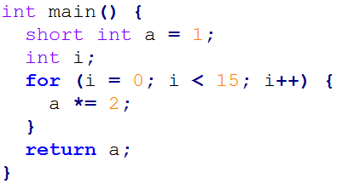
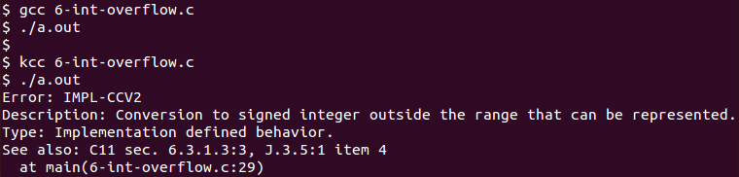
1. Translate K lang def to OCAML 2. Compile OCAML code natively
OCAML backend: K -> OCAML
Code (6-int-overflow.c)
RV-Match: Commercial tool
Instance of K -> OCAML with ISO C11 language
an automatic debugger for subtle bugs other tools can't find, with no false positives
seamless integration with unit tests, build infrastructure, and continuous integration
a platform for analyzing programs, boosting standards compliance and assurance
Conventional compilers do not detect problem
RV-Match’s kcc tool precisely detects and reports error, and points to ISO C11 standard

Slide 17
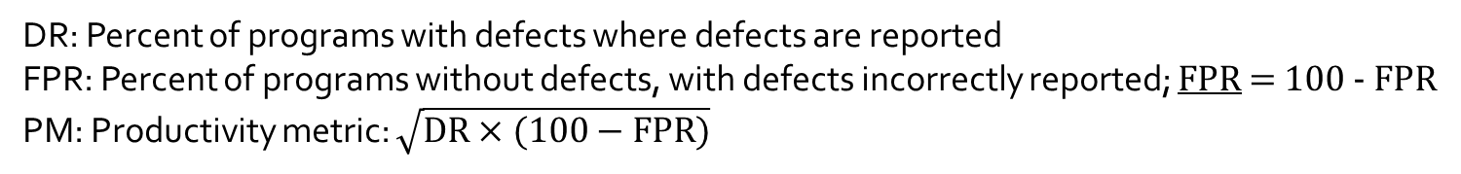
RV-Match on Toyota ITC Benchmark - Comparison with Static Analysis Tools -
[CAV’16]
Toyota Benchmark ISSRE ’15 (1276 tests) | RV-Match |  |  | GrammaTech CodeSonar |  |  | MathWorks Code Prover |  |  | MathWorks Bug Finder |  |  | GCC |  |  | Clang
 | DR | FPR | PM | DR | FPR | PM | DR | FPR | PM | DR | FPR | PM | DR | FPR | PM | DR | FPR | PM
Static memory | 100 | 100 | 100 | 100 | 100 | 100 | 97 | 100 | 98 | 97 | 100 | 98 | 0 | 100 | 0 | 15 | 100 | 39
Dynamic memory | 94 | 100 | 97 | 89 | 100 | 94 | 92 | 95 | 93 | 90 | 100 | 95 | 0 | 100 | 0 | 0 | 100 | 0
Stack-related | 100 | 100 | 100 | 0 | 100 | 0 | 60 | 70 | 65 | 15 | 85 | 36 | 0 | 100 | 0 | 0 | 100 | 0
Numerical | 96 | 100 | 98 | 48 | 100 | 69 | 55 | 99 | 74 | 41 | 100 | 64 | 12 | 100 | 35 | 11 | 100 | 33
Resource management | 93 | 100 | 96 | 61 | 100 | 78 | 20 | 90 | 42 | 55 | 100 | 74 | 6 | 100 | 25 | 3 | 100 | 18
Pointer-related | 98 | 100 | 99 | 52 | 96 | 71 | 69 | 93 | 80 | 69 | 100 | 83 | 9 | 100 | 30 | 13 | 100 | 36
Concurrency | 67 | 100 | 82 | 70 | 77 | 73 | 0 | 100 | 0 | 0 | 100 | 0 | 0 | 100 | 0 | 0 | 100 | 0
Inappropriate code | 0 | 100 | 0 | 46 | 99 | 67 | 1 | 97 | 10 | 28 | 94 | 51 | 2 | 100 | 13 | 0 | 100 | 0
Miscellaneous | 63 | 100 | 79 | 69 | 100 | 83 | 83 | 100 | 91 | 69 | 100 | 83 | 11 | 100 | 34 | 11 | 100 | 34
AVERAGE (Unweighted) | 79 | 100 | 89 | 59 | 97 | 76 | 53 | 94 | 71 | 52 | 98 | 71 | 4 | 100 | 20 | 6 | 100 | 24
AVERAGE (Weighted) | 82 | 100 | 91 | 68 | 98 | 82 | 53 | 95 | 71 | 62 | 99 | 78 | 5 | 100 | 22 | 7 | 100 | 26
DR: Percent of programs with defects where defects are reported
FPR: Percent of programs without defects, with defects incorrectly reported; FPR = 100 - FPR
PM: Productivity metric: $\sqrt{DR×(100−FPR)}$

Slide 18
RV-Match on Toyota ITC Benchmark - Comparison with Other Analysis Tools -
Toyota Benchmark ISSRE ’15 (1276 tests) | RV-Match |  |  | Valgrind + Helgrind (GCC) |  |  | UBSan + TSan + MSan + ASan (Clang) |  |  | Frama-C (Value Analysis Plugin) |  |  | Compcert Interpreter
 | DR | FPR | PM | DR | FPR | PM | DR | FPR | PM | DR | FPR | PM | DR | FPR | PM
Static memory | 100 | 100 | 100 | 9 | 100 | 30 | 79 | 100 | 89 | 82 | 96 | 89 | 97 | 82 | 89
Dynamic memory | 94 | 100 | 97 | 80 | 95 | 87 | 16 | 95 | 39 | 79 | 27 | 46 | 29 | 80 | 48
Stack-related | 100 | 100 | 100 | 70 | 80 | 75 | 95 | 75 | 84 | 45 | 65 | 54 | 35 | 70 | 49
Numerical | 96 | 100 | 98 | 22 | 100 | 47 | 59 | 100 | 77 | 79 | 47 | 61 | 48 | 79 | 62
Resource management | 93 | 100 | 96 | 57 | 100 | 76 | 47 | 96 | 67 | 63 | 46 | 54 | 32 | 83 | 52
Pointer-related | 98 | 100 | 99 | 60 | 100 | 77 | 58 | 97 | 75 | 81 | 40 | 57 | 87 | 73 | 80
Concurrency | 67 | 100 | 82 | 72 | 79 | 76 | 67 | 72 | 70 | 7 | 100 | 26 | 58 | 42 | 49
Inappropriate code | 0 | 100 | 0 | 2 | 100 | 13 | 0 | 100 | 0 | 33 | 63 | 45 | 17 | 83 | 38
Miscellaneous | 63 | 100 | 79 | 29 | 100 | 53 | 37 | 100 | 61 | 83 | 49 | 63 | 63 | 71 | 67
AVERAGE (Unweighted) | 79 | 100 | 89 | 44 | 95 | 65 | 51 | 93 | 69 | 61 | 59 | 60 | 52 | 74 | 62
AVERAGE (Weighted) | 82 | 100 | 91 | 42 | 97 | 65 | 47 | 95 | 67 | 66 | 55 | 60 | 51 | 76 | 63
DR: Percent of programs with defects where defects are reported
FPR: Percent of programs without defects, with defects incorrectly reported; FPR = 100 - FPR
PM: Productivity metric: $\sqrt{DR×(100−FPR)}$

Slide 19






From RV-Match to Blockchain
RV-Match currently commercialized within
The same technology, K, used for defining blockchain languages: EVM, IELE, Plutus, …

Slide 20
Ideal Language Framework Vision [K]
…
Deductive program verifier
Parser
Interpreter
Formal Language Definition
(Syntax and Semantics)
Model checker
Compiler
Symbolic execution
(semantic) Debugger

Slide 21
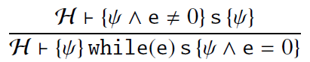
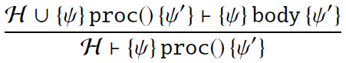
State-of-the-Art
Redefine the language using a different semantic approach (Hoare/separation/dynamic logic)
Language specific, non-executable, error-prone

Slide 22
What We Want
Deductive program verifier
Formal Language Definition
(Syntax and Semantics)
Use directly the trusted
executable semantics!
Language-independent proof system
Takes operational semantics as axioms
Derives reachability properties
Sound and relatively complete for all languages!
Symbolic execution

Slide 23
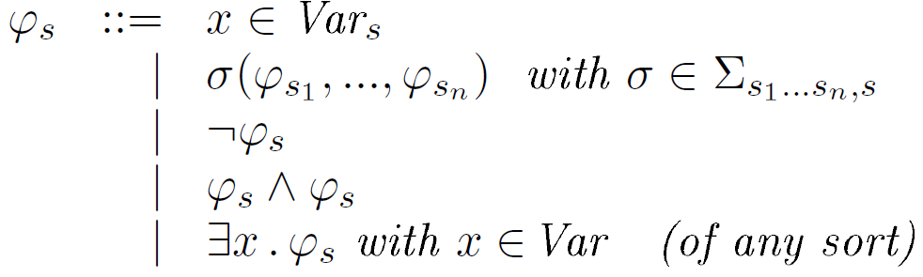
Matching Logic
[…, LICS’13, RTA’15, OOPSLA’16, FSCD’16, LMCS’17, …]
Patterns
(of each sort s)
Structure
Constraints
Binders

Slide 24
Matching Logic Models
Patterns interpreted as sets (all elements that match them)
¬ as complement, ∧ as intersection, ∃ as union over all x

Slide 25
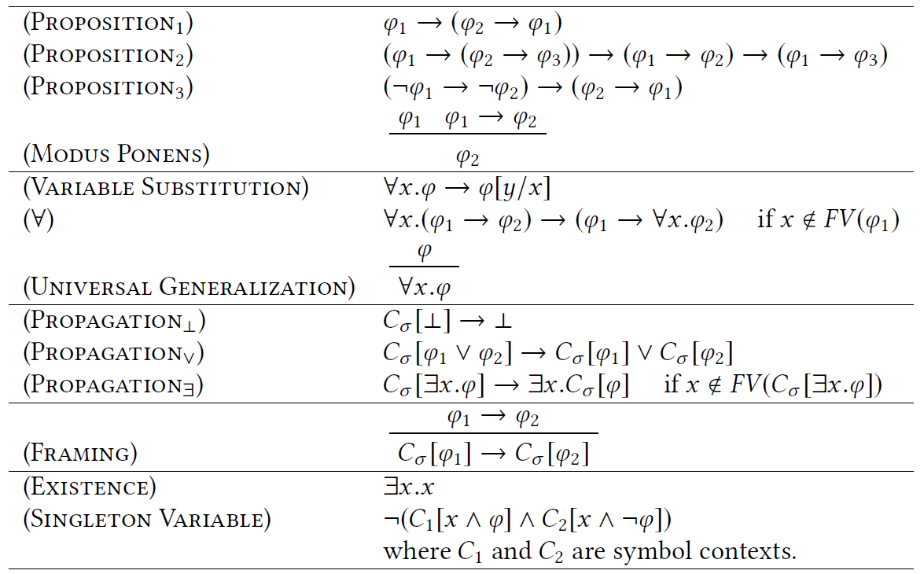
Matching Logic Proof System
First-Order Logic
13 Proof rules. Sound and complete
C_{σ} ≡ σ(ψ₁,…, ψ_{i-1},□, ψ_{i+1},…, ψ_{n})
Technical (completeness)
Local reasoning

Slide 26
Expressiveness
Important logics for program reasoning can be framed as matching logic theories / notations
First-order logic
Equality, membership, definedness, partial functions
Lambda / mu calculi (least/largest fixed points)
Modal logics
Hoare logics
Dynamic logics
LTL, CTL, CTL*
Separation logic
Reachability logic
…
λx.e ≡ ∃x.λ⁰(x,e)
(λx.e)e’ = e[e’/x]
μx.e ≡ ∃x. μ⁰(x,e)
μx.e = e[μx.e/x]
[e[ψ/x] → ψ] → [μx.e → ψ]
Knaster-Tarski

Slide 27
Expressiveness
Important logics for program reasoning can be framed as matching logic theories / notations
First-order logic
Equality, membership, definedness, partial functions
Lambda / mu calculi (least/largest fixed points)
Modal logics
Hoare logics
Dynamic logics
LTL, CTL, CTL*
Separation logic
Reachability logic
…

Slide 28
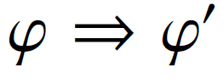
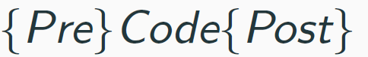

Reachability Logic (Semantics of K) [LICS’13, RTA’14, RTA’15,OOPLSA’16]
“Rewrite” rules over matching logic patterns:
Patterns generalize terms, so reachability rules capture rewriting, that is, operational semantics
Reachability rules capture Hoare triples
Sound & relative complete proof system
Now proved as matching logic theorems
Can be expressed in matching logic:
ϕ → ◊(ϕ’) ◊ is “weak eventually”
[FM’12]
≡

Slide 29
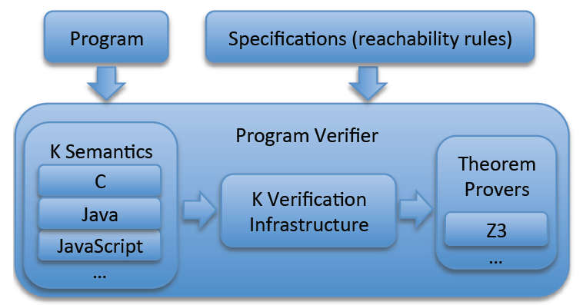
K = (Best Effort) Implementation of RL
Reachability logic implemented in K, generically
Evaluated it with the existing semantics of C, Java, and JavaScript, and several tricky programs
Morale:
Performance is not an issue!
EVM
IELE
Plutus
Solidity
…

Slide 30
OK Performance
Time (seconds) spent on applying semantic steps (symbolic execution)
Time (seconds) spent on domain reasoning (matching logic + querying Z3)
[OOPLSA’16]
Properties very challenging to verify automatically. We only found one such prover for C, based on a separation logic extension of VCC
Which takes 260 sec to verify AVL insert (ours takes 280 sec; see above)

Slide 31
K for the Blockchain

Slide 32

KEVM: Semantics of the Ethereum Virtual Machine (EVM) in K
[CSL’18]
Complete semantics of EVM in K
https://github.com/kframework/evm-semantics
Passes 60,000+ tests of C++ reference implementation
One order of magnitude slower than C++ implementation

Slide 33
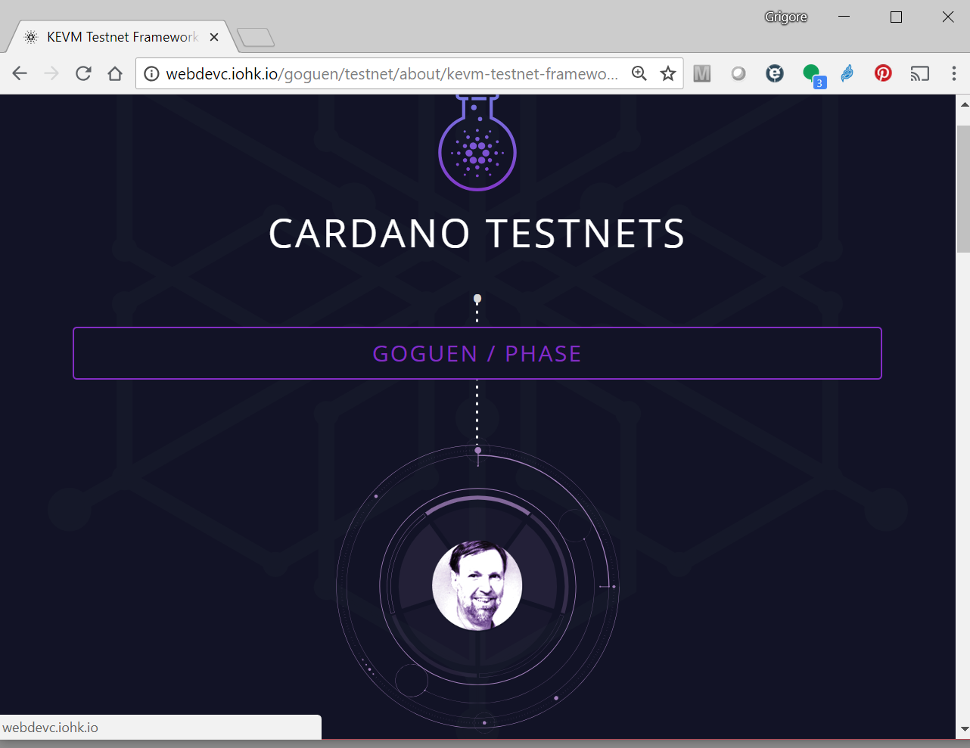
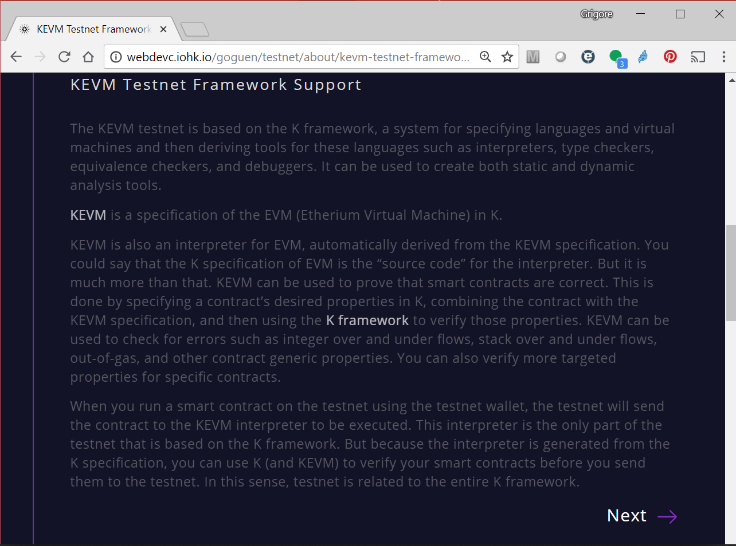
What Can We Do with KEVM?
1) Generate and deploy correct-by-construction EVM client! IOHK has just done that, in collaboration with RV, as a Cardano testnet:

Slide 34
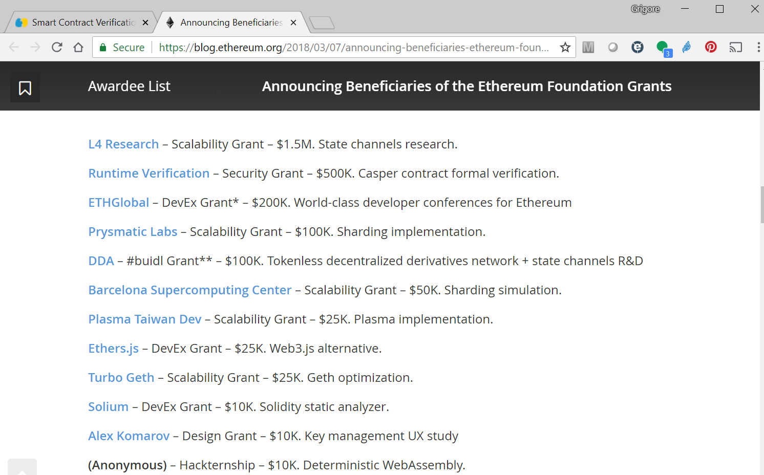
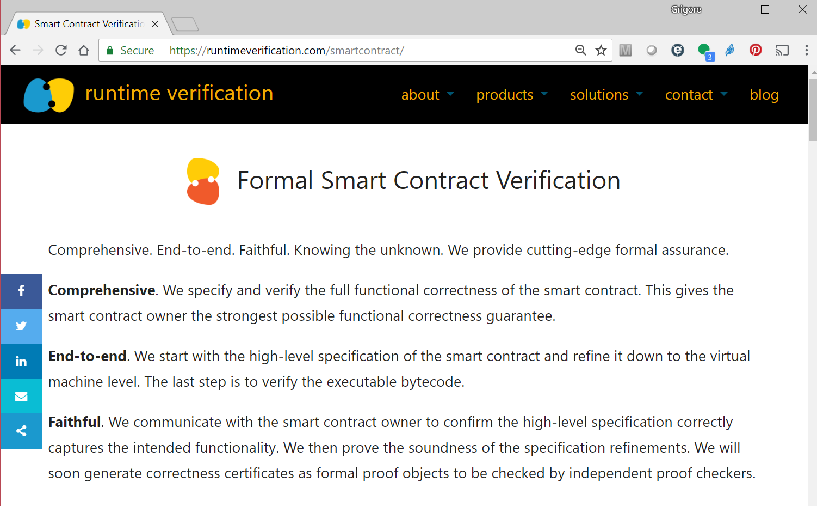
What Can We Do with KEVM?
2) Formally verify Ethereum smart contracts! RV is doing that, commercially. RV also won Ethereum Security grant to verify Casper.

Slide 35
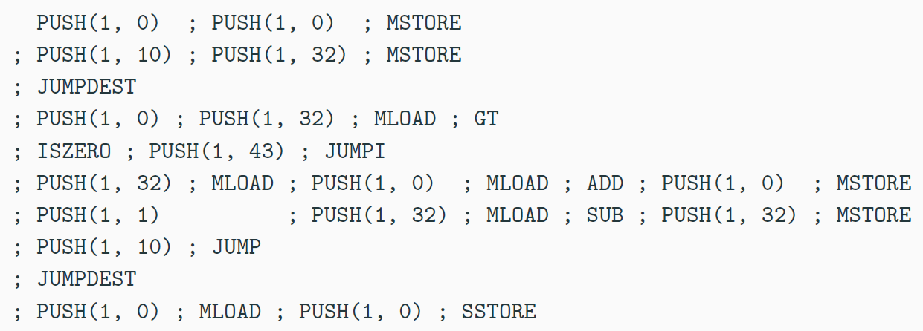
EVM Not Human Readable (among other nuisences)
If it must be low-level, then I prefer this:
define public @sum(%n) {
%result = 0
condition:
%cond = cmp le %n, 0
br %cond, after_loop
%result = add %result, %n
%n = sub %n, 1
br condition
after_loop:
ret %result
}

Slide 36

A New Virtual Machine (and Language) for the Blockchain
IELE testnet (with IOHK):
End of July’18
With tool ecosystem
Incorporates learnings from defining KEVM and from using it to verify smart contracts
Register-based machine, like LLVM; unbounded*
IELE was designed and implemented using formal methods and semantics from scratch!
Until IELE, only existing or toy languages have been given formal semantics in K
Not as exciting as designing new languages
We should use semantics as an intrinsic, active language design principle, not post-mortem

Slide 37
K Semantics of Other Blockchain Languages
WASM (web assembly) – in progress, by the Ethereum Foundation
Solidity – in progress, collaboration between RV and Sun Jun’s group in Singapore
Plutus (functional) – in progress, by RV following Phil Wadler’s (@IOHK) design of the language
Vyper – in progress, by RV in collaboration with the Ethereum Foundation
…

Slide 38
Ongoing K Infrastructure Projects

Slide 39
1. Fast LLVM (and IELE) Backend for K
Current OCAML backend of K:
Fast enough to power RV-Match product and the KEVM and IELE VMs in testnets
But still one or two orders of magnitude slower than hand-crafted interpreters
LLVM backend for K under development:
Take advantage of LLVM’s optimizations / pipeline
Expected to compete with hand-written interpreters
IELE backend of K will be developed similarly
…
Deductive program verifier
Parser
Interpreter
Formal Language Definition
(Syntax and Semantics)
Model checker
Compiler
Symbolic execution
(semantic) Debugger

Slide 40
2. Semantics-Based Compilation
…
Parser
Deductive program verifier
Interpreter
Formal Language Definition
(Syntax and Semantics)
Model checker
Compiler
Symbolic execution
(semantic) Debugger

Slide 41
Semantics-Based Compilation (SBC)
𝕂 Semantics of Language L
Semantics-Based Compilation
𝕂 Semantics of Language L_{P}
Program P in Language L
Goals
Execution of P in L equivalent to executing L_{P} in a start configuration
L_{P} should be “as simple as possible”, only capturing exactly the dynamics of L necessary to execute program P

Slide 42
Semantics-Based Compilation (SBC)
Experiments with Early Prototype
// start
int b , n , x ;
b = 1 ; n = 1 ; x = 0 ;
// outer
while (b <= 27) {
n = b ;
// inner
while (2 <= n) {
if (n <= ((n / 2) * 2)) {
n = n / 2 ;
} else {
n = (3 * n) + 1 ;
}
x = x + 1 ;
}
b = b + 1 ;
}
// end
compiles to
Program | Original (s) | Compiled (s) | Speedup
sum.imp | 70.6 | 7.3 | 9.7
collatz.imp | 34.5 | 2.7 | 12.8
collatz-all.imp | 77.4 | 5.7 | 13.6
krazy-loop.imp | 67.6 | 3.3 | 20.5

Slide 43
3. Proof Object Generation
Each and every one of the K tools is a best-effort implementation of proof search in Matching Logic
New Haskell implementation of K will generate such proof objects explicitly
No need to trust the (complex) K implementation
Proof objects to be used as third-party checkable correctness certificates on the blockchain
…
Parser
Deductive program verifier
Interpreter
Formal Language Definition
(Syntax and Semantics)
Model checker
Compiler
Symbolic execution
(semantic) Debugger

Slide 44


K – A Universal Blockchain Language
We want to be able to write (provably correct) smart contracts in any programming language!
Solidity
V0.2.21
Solidity
V0.2.22
Plutus
V1.3.5
K language semantics will be stored on blockchain

Slide 45
K – A Universal Blockchain Language
We want to be able to write (provably correct) smart contracts in any programming language!
Solidity
V0.2.21
Solidity
V0.2.22
Plutus
V1.3.5
1. Write contract P in any language, say L (unique address)
2. SBC[L] your P into L_{P} ; optionally verify P with Kprover[L]
3. Generate IELE binary P_{IELE} from L_{P} using IELE backend
4. Formally verify P_{IELE} with Kprover[IELE]

Slide 46
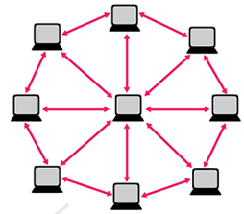
K – A Universal Blockchain Language
Everything is either a trusted formal specification or generated automatically from one.
No compromise!
Proof objects will serve as correctness certificates.
We want to be able to write (provably correct) smart contracts in any programming language!
Each node runs a IELE VM client, generated from IELE semantics through LLVM backend.

Slide 47
Conclusion: It Can Be Done!
…
Deductive program verifier
Parser
Interpreter
Formal Language Definition
(Syntax and Semantics)
Model checker
Compiler
Symbolic execution
(semantic) Debugger

